Slide 1
Concept Design Review
Designers: Ernesto Huerta, Nate Furbeyre, Josh Plasket, Will Sirski
Notes:
WILL
Introduce group
Roadmap:
-problem definition
-vehicle simulation
-transmission options
-transmission selection

Slide 2
Battery selection
Design Requirements
Acceleration and Range
Primary Factors to Consider
Capacity (Amp-hours)
Voltage (Volts)
Discharge Current (Amps)
Rated Energy (kWh)
Types of Batteries
Lithium Ion vs Lead Acid
Depth of Discharge
Life Expectancy
Notes:
NATE
Design Requirements
Need to have sufficient power from the battery to supply to the motor for acceleration and maintain top speed of at least 65mph
Need to satisfy the required range of 40 miles
Factors to Consider
The capacity is ultimately the driving factor for the range of the vehicle. If there is a low capacity to the battery, it will not be sufficient in making the entire trip that the car needs to go on
Voltage plays a role in the amount of power that the car systems can output. The motor can handle a range of different voltages, but if the voltage is too small, the car will not be able to accelerate quickly
Discharge current is the suggested current to be drawn from the battery. It is the other main component in the amount of power that the battery can supply
Rated Energy is the total energy that the battery contains and is calculated by multiplying the capacity and the voltage of the battery together. It is often a headlining specification when browsing for different batteries.
Types of Batteries
There are a variety of different types of batteries to use in EVs, but for most purposes they fall into two categories. There is a major tradeoff between lithium ion and lead acid batteries.
Lithium ion batteries are the new, state of the art batteries that will be the most efficient and powerful. They come with a significantly higher price tag.
Lead acid batteries have been around for a long time and are consistent and reliable. Relatively inexpensive, but very heavy.
Depth of Discharge
It is recommended to only discharge the battery 20-25% of its capacity. Going past this mark will reduce the battery life expectancy.
Transmission needs to be designed to last 10 years. Battery should have a similar life expectancy

Slide 3
Vehicle Loads
Resistive forces to consider
Rolling
Inertias
Tire friction
Drag
Cross section of car
Bearing
Types of bearings
Driveshaft
Transmission
Creating MATLAB® function to calculate traction Force
Inputs
Velocity, acceleration, angle of road, and mass equivalent
Notes:
ERNESTO
Where the information comes from
Types of bearings later in design process
Extra research completed
Calculating the resistive force simplified and conservative
Inputs: velocity, acceleration, angle of road, mass equivalent

Slide 4
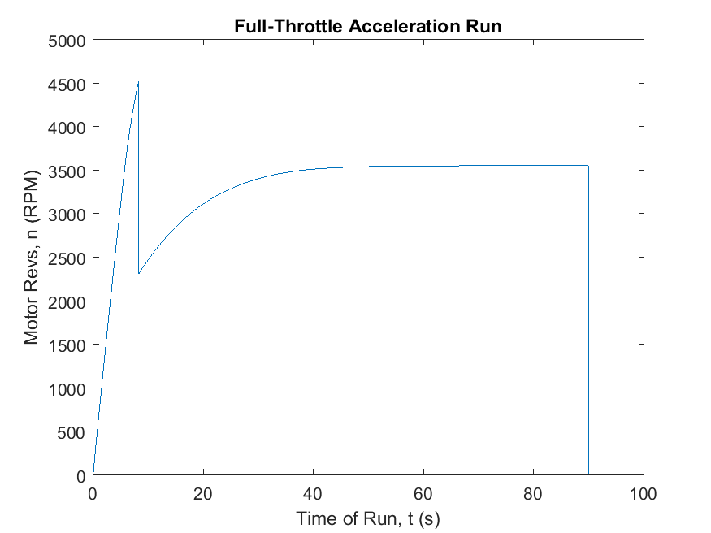
Vehicle Dynamics-Gear Ratios
Gear 1: 1.40:1
Gear 2: 0.714:1
Shift Point: 4530 RPM
Notes:
WILL
Gear Ratios:
-report of final ratio choices
-explanation of integration method
-gear ratio doesn’t affect battery life much

Slide 5
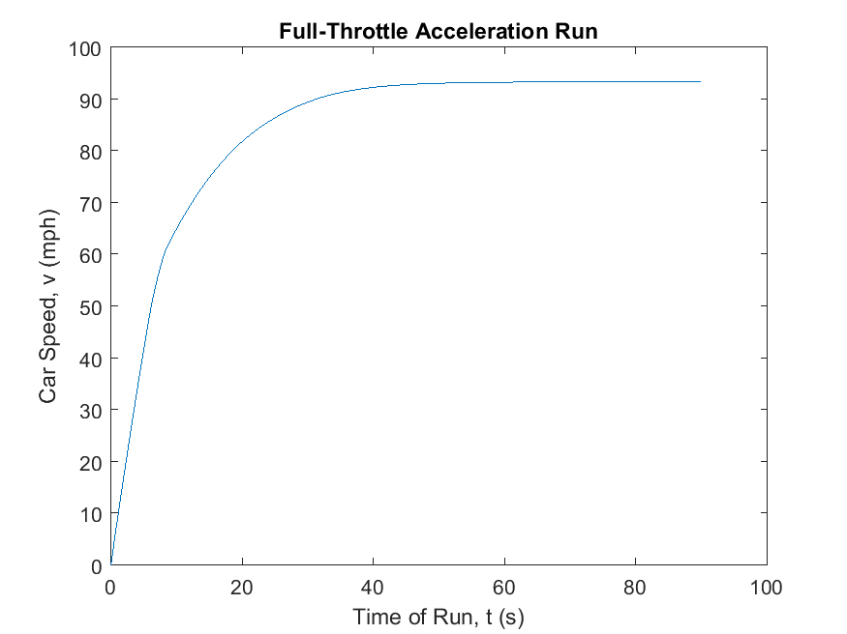
Vehicle Dynamics-Performance
Battery FS: 1.7 (1.8)
0-60 (no passenger): 8.2 s (7.4 s)
Top Speed: 93 mph (94 mph)
Notes:
WILL
Performance:
-explanation of battery life integration
-talk about final performance.

Slide 6
Transmission types
Planetary
Dual Clutch
Sequential
Dog Box Manual
Notes:
ERNESTO

Slide 7
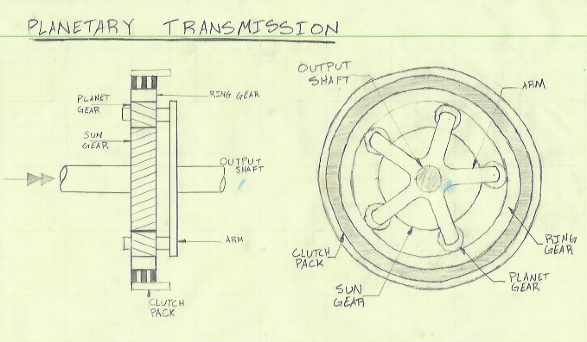
Planetary Transmission Concept
Notes:
ERNESTO
Overview:
Automatic transmission use
Electronically shifted
Multiple gear options in one system
Key features:
Gears always remain in contact
Pros:
Easy to drive
Utilizes one clutch in order to lock components
Cons:
Difficult to design and making operational
Difficult to service

Slide 8
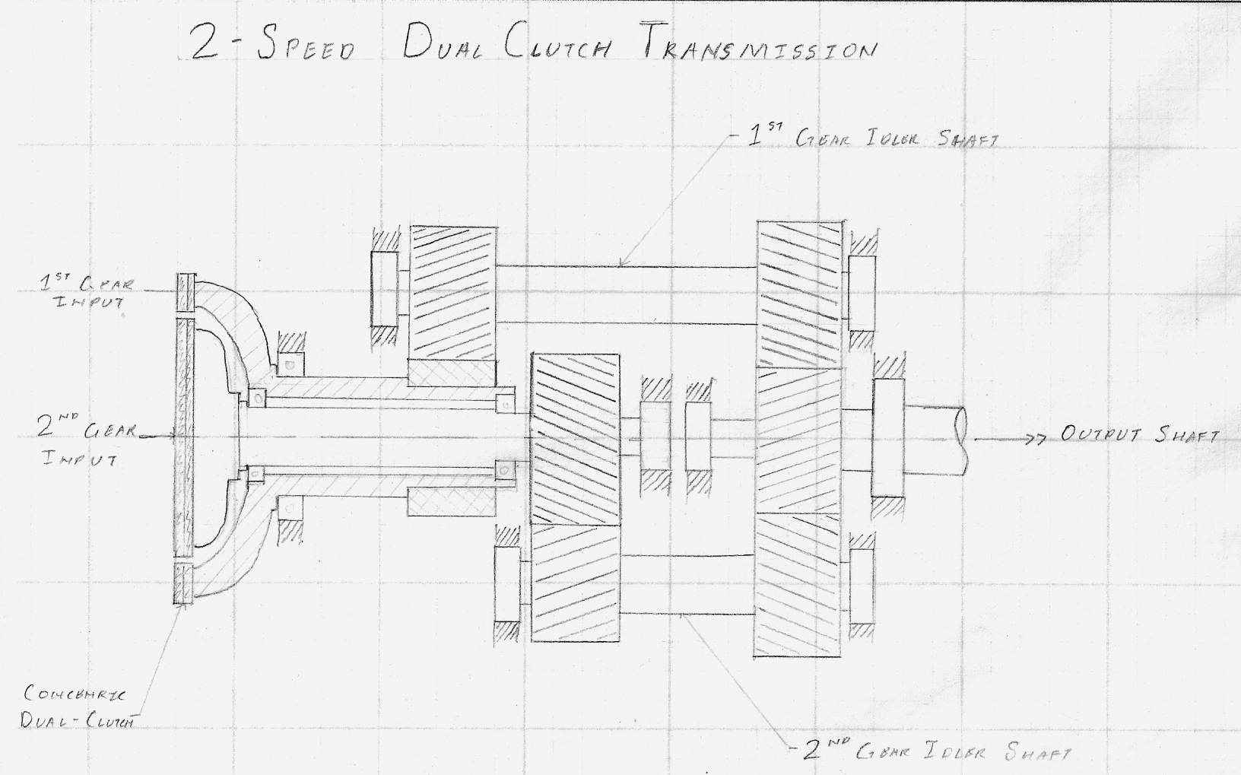
Dual Clutch Transmission Concept
Dual Clutch
Notes:
WILL
Dual-clutch transmission:
Overview:
-2 clutches for 2 idler shafts
-one shaft deals with odd gears, one with evens
-generally used in high-performance cars
Key features:
-concentric dual clutch is the cornerstone of the concept
Pros:
-incredibly fast shifting
-robust design
-complex dual clutch can be purchased
Cons:
-significant hydraulic/mechatronic components required
-concentric shafts require additional machining
-not smooth

Slide 9
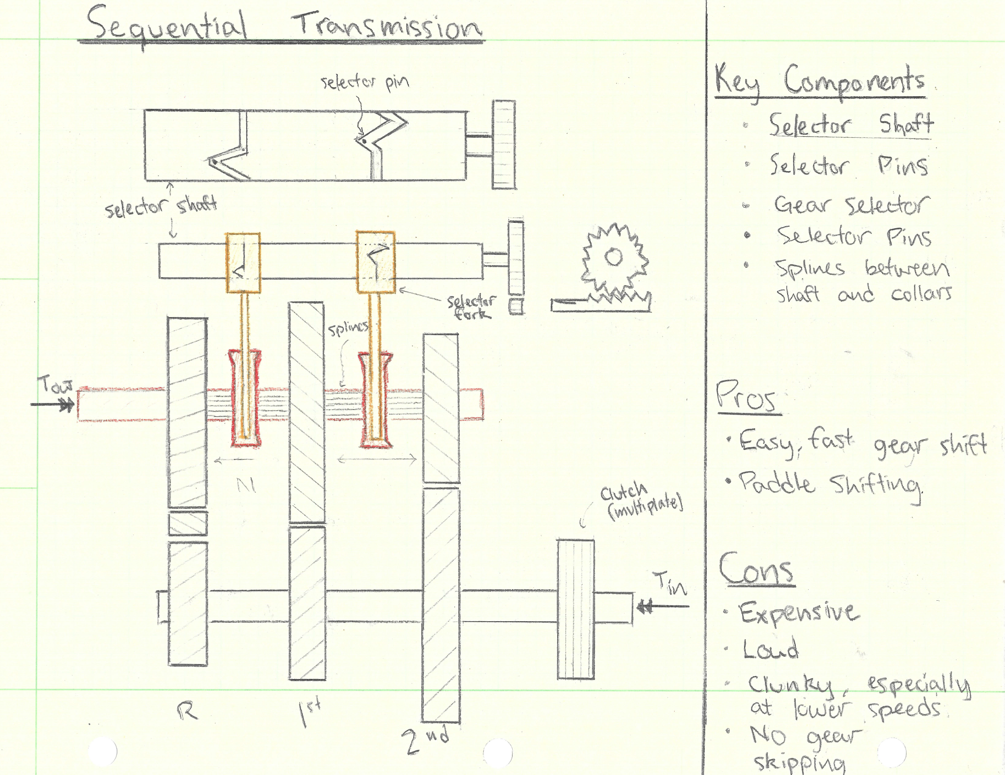
Sequential Transmission Concept
Notes:
NATE
Sequential Transmission is not common; typically only found in motorcycles or high end racecars.
How the transmission works
Few things that make this transmission unique: the sector shaft shown on the top of the diagram, the yellow gear selectors cuffed around the selector shaft with a selector pin rigidly attached to the selector fork and the collar connected to the output shaft via splines.
Important: all gears are in constant mesh. What causes transmission of power from the input shaft to the output shaft is depends on which gear set the collar is engaged with.
Shift gears by moving the rack left or right on the right side of the diagram. Causes the selector shaft to rotate via the pinion.
Selector shaft has grooves which are concentric along the shaft’s axis. The selector pin rides this groove and when it hits a zigzag in the grove, the entire fork must translate left or right on the diagram.
Red colors attached to the selector fork will engage with gearset to transmit the rotating gear to the collar and output shaft.
Zig zags in the selector shaft are oriented so that only one collar is engaged with a gear; the rest are in neutral.
Pros
Very quick and easy gear shifting
Fashionable with the paddle shifting
Cons
Very expensive, and can have a loud whine
Not the smoothest feel, especially at lower speeds
No gear skipping, although this doesn’t really matter for a two speed transmission

Slide 10
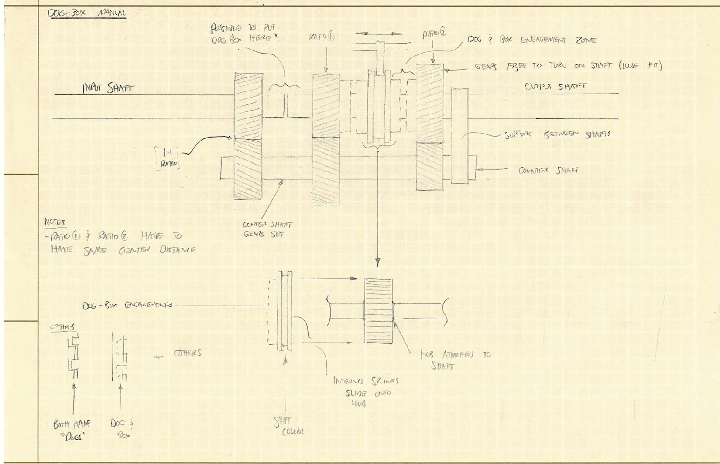
Dog Box Transmission Concept
Notes:
JOSH
Overview: Dogbox manual is most commonly found in racecars and sequential gearboxes. This a much faster shifting gearbox that uses dog gears to change gears instead of a synchronizer.
Key features:
Dog and Box or Dog and Dog teeth engagement from one gear to another
Pros:
Fast shifting
Stronger than syncro
Durable
Cons:
Must be shifted fast
Loud “clunk” when shifting

Slide 11
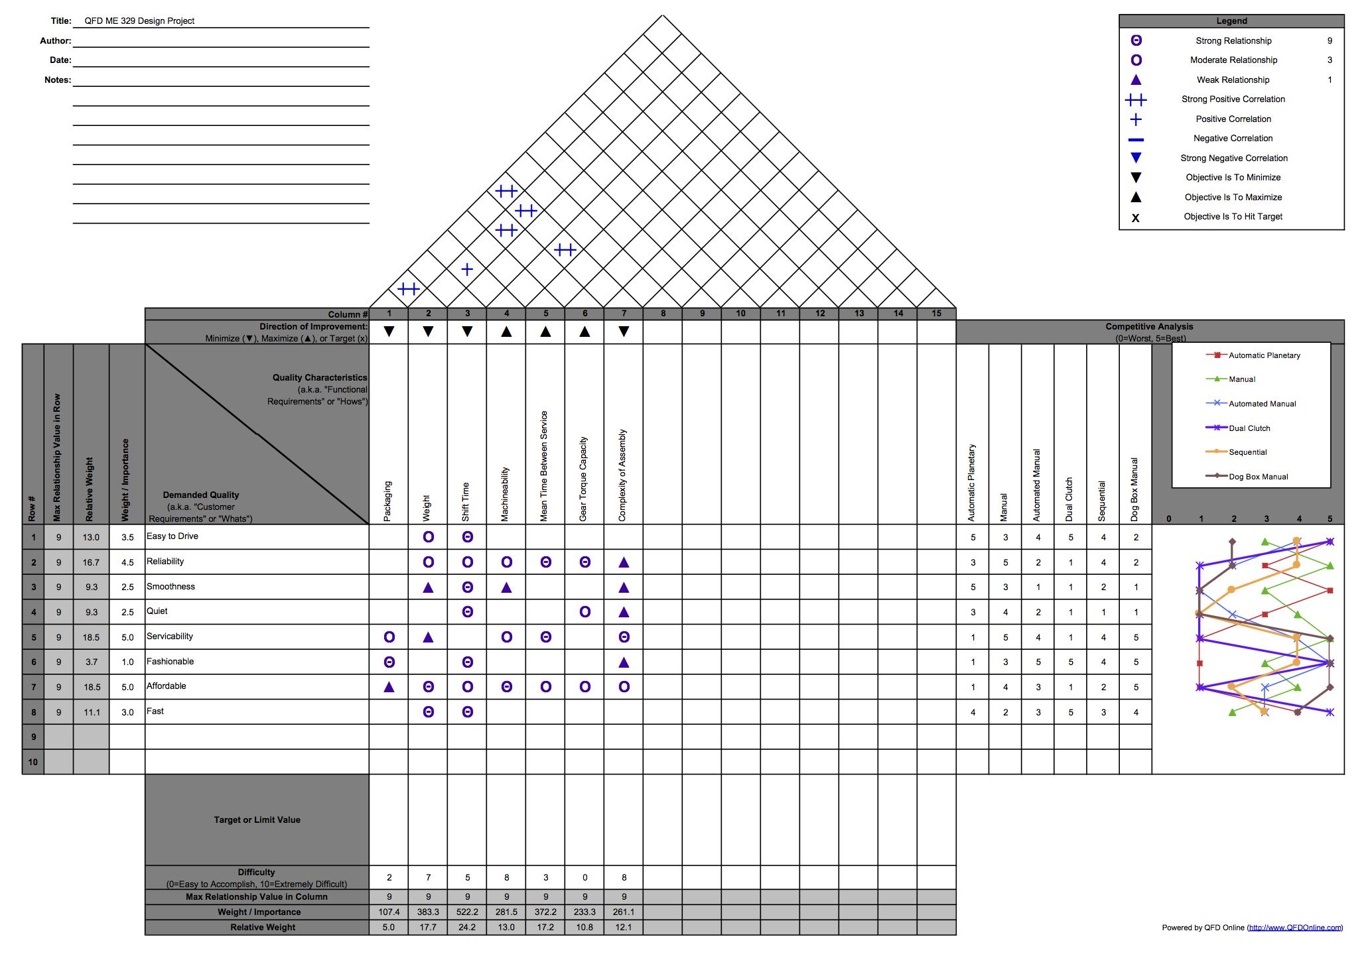
Deciding Factors and Quality
Notes:
ERNESTO
Quality characteristics of Engineering requirements versus user defined requirements
Relates the two in center of matrix
Strong, weak, or no relationship
Left is user defined characteristics
Weight importance out of 5
Top is engineering characteristics
Whether it is maximized
Difficulty to complete (Bottom) out of 10
Triangle: how the engineering requirements are correlated
Far right is how the different transmission types relate to the user defined characteristics but is not important for design
We want to use QUANTITATIVE values not qualitative.
Weight factors for bottom used in decision matrix

Slide 12
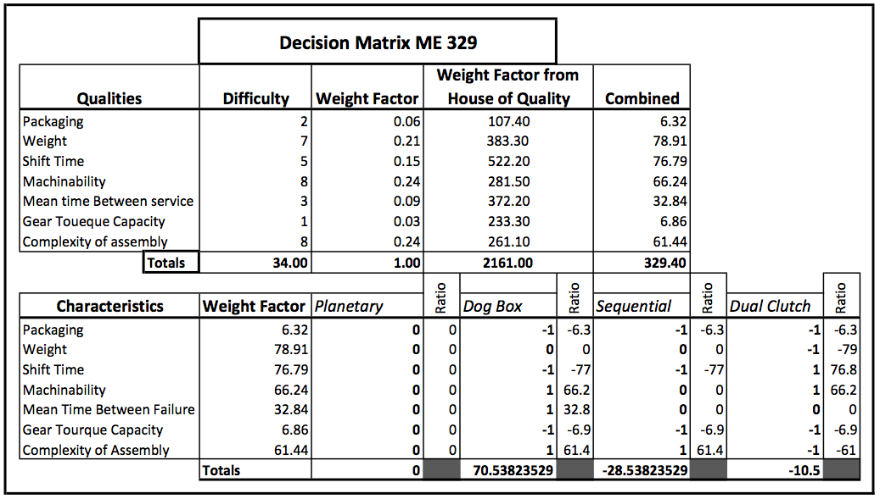
Decision Matrix
Notes:
ERNESTO
First set of rows sets up the multipliers for each engineering specification
Difficulty ratio relative to the difficulty of other specifications out of 10
Weight factor from House of Quality
Combination of two
Four transmission types
Planetary set as baseline
Other three +1, 0, -1 as better than, neutral or worse than planetary
Dog Box decided for the continuation of project

Slide 13
Transmission Selected - Dog Box Manual
Pros-
-Simplicity of design
-Strength
-Very Fast shifting
Cons-
-Loud gear change
-Must be shifted fast
Selected the best design elements from our concepts. Very similar to a standard manual transmission and with only two gears, a sequential transmission.
Selected a dog box manual transmission
Notes:
JOSH
The best of each of our concepts

Slide 14
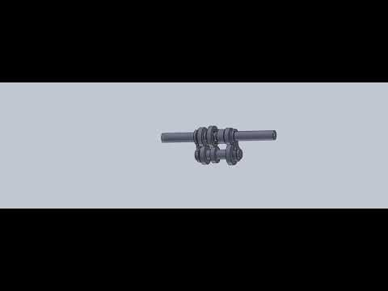
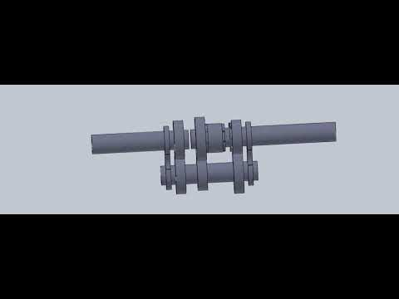
Notes:
JOSH
MORE SOLIDWORKS STUFF (VIDEO)

Slide 15
Closing Remarks
Final Performance
0-60 mph: 7.2 seconds
Top Speed: 94 mph
Gear Ratios
1.40:1, 0.714:1
Transmission
Dog Box
Here comes the fun part…
Notes:
ERNESTO

